Slide 1

WEEK 5
JavaScript Basic III Level 4 Introduction to Internet Software Architecture

Slide 2
Previous week
Arrow Function
Anonymous Function
IIFE (Immediately Invoked Function Expression)
Higher Order Function
Map
Reduce
Filter
ForEach Iteration
HTML DOM
Virtual DOM
JavaScript Selectors
Exploring JavaScript Events and event handlers

Slide 3
Week 4 Lecture Topic
Understanding Asynchronous Scripting
Callback functions and Callback Hell
JavaScript Promises
Fetch Method
Axios

Slide 4

4. Asynchronous JavaScript…

Slide 5

Introduction
1. Asynchronous
2. Call back functions
3. Promises
4 Fetch Method
5 API
6 JSON
7. Learn more
JavaScript Basics III

Slide 6
Asynchronous
1. Asynchronous
2. Call back functions
3. Promises
4 Fetch Method
5 API
6 JSON
2. Learn more
JavaScript is a single-threaded programming language, which means only one thing can happen at a time.
JavaScript engine can only process one statement at a time in a single thread.
While single-threaded languages simplify writing codes because you don’t have to worry about the concurrency issues, this also means you cannot perform long operations such as network access without blocking the main thread.
A good example of this happening is the window alert function alert("Hello World")

Slide 7
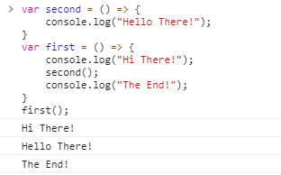
Asynchronous
1. Asynchronous
2. Call back functions
3. Promises
4 Fetch Method
5 API
6 JSON
2. Learn more
Using Asynchronous JavaScript (AJAX, Callback, Promises, async-await), you can perform long network requests without blocking the main thread.
Let's take an example of a synchronous programming in JavaScript:

Slide 8
Asynchronous
1. Asynchronous
2. Call back functions
3. Promises
4 Fetch Method
5 API
6 JSON
2. Learn more
From the above example, the console will log, “Hi There!”, “Hello There!” and “The End!” sequentially.
As you can see, JavaScript logs the later statements only after the above statement is completed.
Now, let's take a look at how a basic asynchronous programming works.
We will use a setTimeout() function to achieve that. Remember this function is not a JavaScript function but rather a Web API (browser-function).

Slide 9
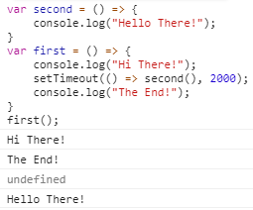
Asynchronous
1. Asynchronous
2. Call back functions
3. Promises
4 Fetch Method
5 API
6 JSON
2. Learn more
Now, if you try this code in your browser, this will log “Hi There!”, “The End!” and then wait 2 seconds to log “Hello There!”.
This way the code worked on two different thread without blocking the main thread.

Slide 10
Asynchronous
1. Asynchronous
2. Call back functions
3. Promises
4 Fetch Method
5 API
6 JSON
2. Learn more
Although setTimeout() is not the best way to achieve all asynchronous programming, but is enough to help you understand how asynchronous JavaScript works.
We will now move more into the asynchronous JavaScript. Lets have a look at Ajax, Callback functions and Promises.

Slide 11
Callback Functions
1. Asynchronous
2. Call back functions
3. Promises
4 Fetch Method
5 API
6 JSON
2. Learn more
A callback function is a function that is passed as an argument to another function, to be “called back” at a later time.
A callback function can either be a general function or an anonymous function.
Callback functions are great way to handle something after something else has been completed. By something here we mean a function execution.
If we want to execute a function right after the return of some other function, then callback can be used.

Slide 12
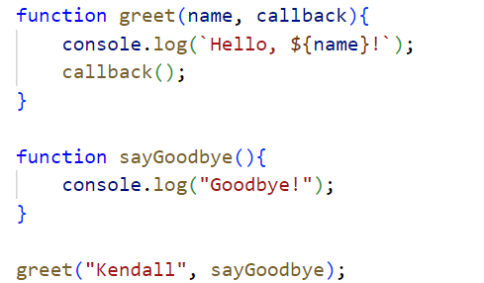

Callback Functions
1. Asynchronous
2. Call back functions
3. Promises
4 Fetch Method
5 API
6 JSON
2. Learn more
Example:
We have taken two functions: greet and sayGoodbye.
The greet takes two parameters:name(String) and
callback(a function).It logs a greeting message using
the provided name and then calls the callback
function.
When we call greet
(“Kendall”, sayGoodbye), it will output:

Slide 13
Callback Functions
1. Asynchronous
2. Call back functions
3. Promises
4 Fetch Method
5 API
6 JSON
2. Learn more
For JavaScript to know when an asynchronous operation has a result, it points to a function that will be executed once the result is ready. That function is called a callback function.
Here the result can either be the data or an error that occurred during the process.

Slide 14
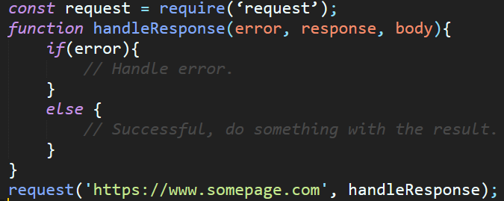
Callback Functions
1. Asynchronous
2. Call back functions
3. Promises
4 Fetch Method
5 API
6 JSON
2. Learn more
Here is a simple example of callback function.

Slide 15
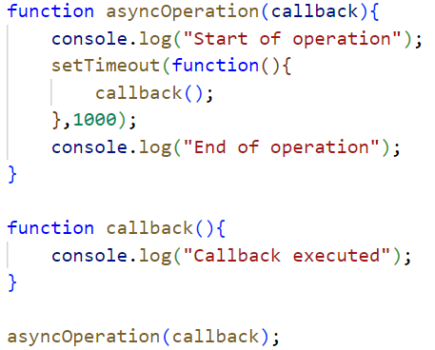
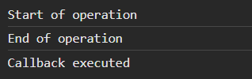
Callback Functions
1. Asynchronous
2. Call back functions
3. Promises
4 Fetch Method
5 API
6 JSON
2. Learn more
Example:
The asyncOperation function uses
setTimeOut to stimulate asynchronous task.
The callback is executed after a delay of
1 second.
Output:

Slide 16
Callback Functions/Callback hell
1. Asynchronous
2. Call back functions
3. Promises
4 Fetch Method
5 API
6 JSON
2. Learn more
Callbacks are a good way to declare what will happen once an I/O operation has a result, but what if you want to use that data in order to make another request?
You can only handle the result of the request within the callback function provided.

Slide 17
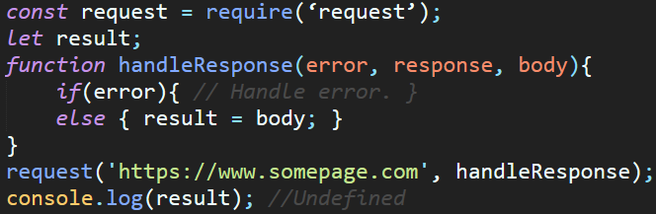
Callback Functions/Callback hell
1. Asynchronous
2. Call back functions
3. Promises
4 Fetch Method
5 API
6 JSON
2. Learn more
In this example the variable “result” will not have a value when printed to the console at the last line. With it we are unable to continue with our second request.

Slide 18
Callback Functions/Callback hell
1. Asynchronous
2. Call back functions
3. Promises
4 Fetch Method
5 API
6 JSON
2. Learn more
To continue with our second request, we need to create another callback function inside our previous callback function.
This will make our code messy to read and very difficult to understand.
With that pattern, it means we need to check for errors in every callback. Which just adds to the mess when dealing with multiple requests and callbacks.
This anti-pattern is what we call Callback Hell.

Slide 19
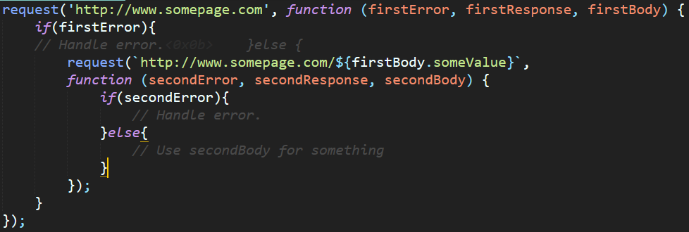
Callback Functions/Callback hell
1. Asynchronous
2. Call back functions
3. Promises
4 Fetch Method
5 API
6 JSON
2. Learn more

Slide 20
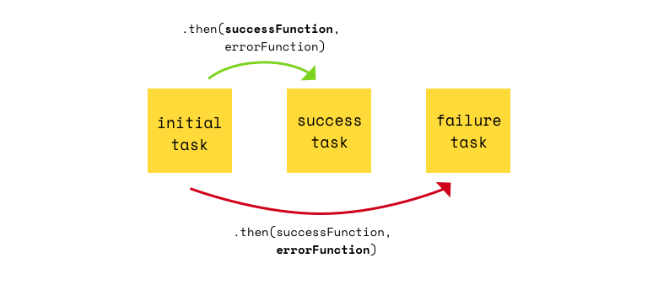

Slide 21
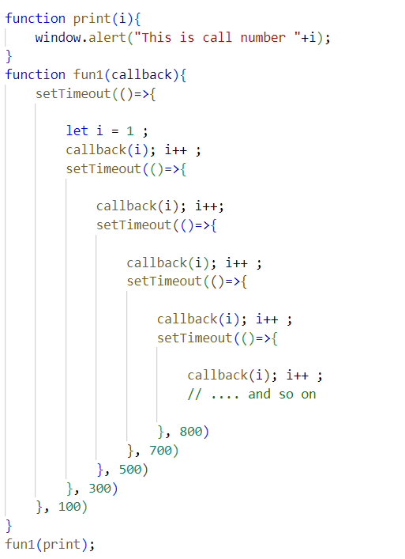
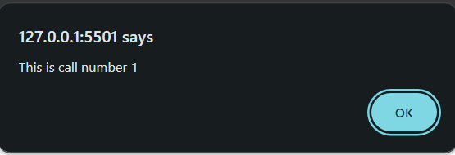
Callback Functions/Callback hell
1. Asynchronous
2. Call back functions
3. Promises
4 Fetch Method
5 API
6 JSON
2. Learn more
We nested and called the Callback inside the
setTimeout() method. The Callback will execute
all calls to the print() function in its specified time.
Here, we can see the complexity of calling the
Callback method in a nesting method. The code
becomes difficult to comprehend and debug.
Output:

Slide 22
Promises
1. Asynchronous
2. Call back functions
3. Promises
4 Fetch Method
5 API
6 JSON
2. Learn more
A promise is an object that wraps an asynchronous operation and notifies when its done.
They are easy to manage when dealing with multiple asynchronous operations where callbacks can create callback hell leading to unmanageable codes.
Promises are the ideal choice for handling asynchronous operations in the simplest manner. They can handle multiple asynchronous operations easily and provide better error handling than callbacks.
Promise always returns a response.

Slide 23
Promises
1. Asynchronous
2. Call back functions
3. Promises
4 Fetch Method
5 API
6 JSON
2. Learn more
Instead of providing a callback, promises has its own method which you call to tell the promise what will happen if it is successful or when it fails.
The methods a promise provides are “then(…)” for when a successful result is available and “catch(…)” for when something went wrong.
The next example uses the native Promises as introduced in ES6.

Slide 24
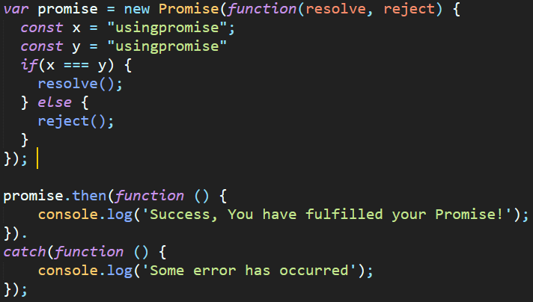
Promises
1. Asynchronous
2. Call back functions
3. Promises
4 Fetch Method
5 API
6 JSON
2. Learn more
A side note here, variable “promise” itself is not a promise but a function that returns a promise.

Slide 25
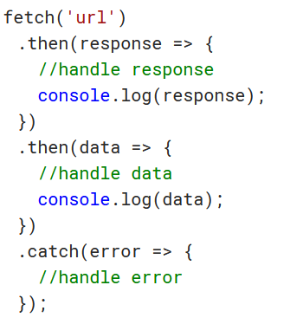
Fetch Method
1. Asynchronous
2. Call back functions
3. Promises
4 Fetch Method
5 API
6 JSON
2. Learn more
It is a promise-based interface for fetching resources by making HTTP requests to servers from web browser.
It is better and more powerful than XML HTTP requests.
Fetch API comes with a fetch() method that allows you to fetch data making an HTTP request i.e. a GET request(getting data) or POST request(for posting data).
Fetch method syntax:

Slide 26
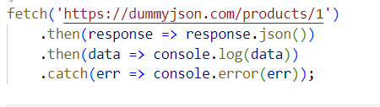
Fetch Method
1. Asynchronous
2. Call back functions
3. Promises
4 Fetch Method
5 API
6 JSON
2. Learn more
In this fetch method, API endpoint is passed as an argument which provides access to a single product.
Calling this fetch() method returns a special JavaScript object called promise.
We have chained the fetch method with a then() method to investigate the Response object we got from the API call.

Slide 27
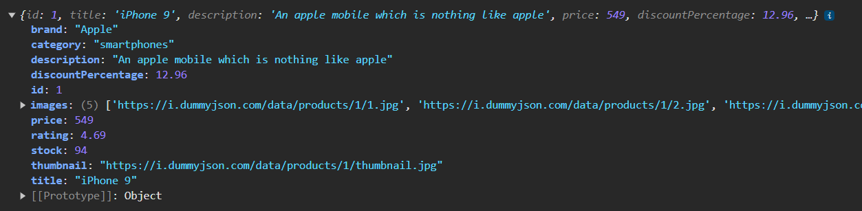
Fetch Method
1. Asynchronous
2. Call back functions
3. Promises
4 Fetch Method
5 API
6 JSON
2. Learn more
The Response object is assigned to a response variable. (You can give the Response object any variable name of choice, res or response is the convention)
Use the json() method to view the complete content of the fetched resource ( For instance res.json() or response.json() depending on how you named your variable)
The output will be an Object containing some dummy product data- title,description,price,etc.

Slide 28
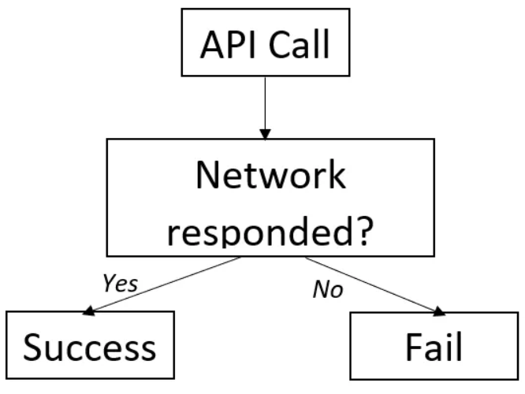
Promises
1. Asynchronous
2. Call back functions
3. Promises
4 Fetch Method
5 API
6 JSON
2. Learn more
Handling the status code of the response
An HTTP status code is a server response to a browser’s request.
The server responds it to the browser’s request with a three-digit code and a status text.
A successful response will give a status code of 200 and a status text of OK.
If the requested URL throws a server error, the status code will be 500.
If the requested resource does not exist, the status code will 400 and status text will be Not found.

Slide 29
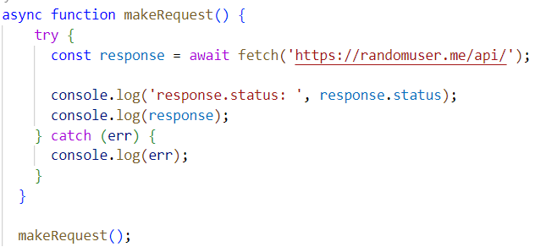
Promises
1. Asynchronous
2. Call back functions
3. Promises
4 Fetch Method
5 API
6 JSON
2. Learn more
Example: status code 200

Slide 30
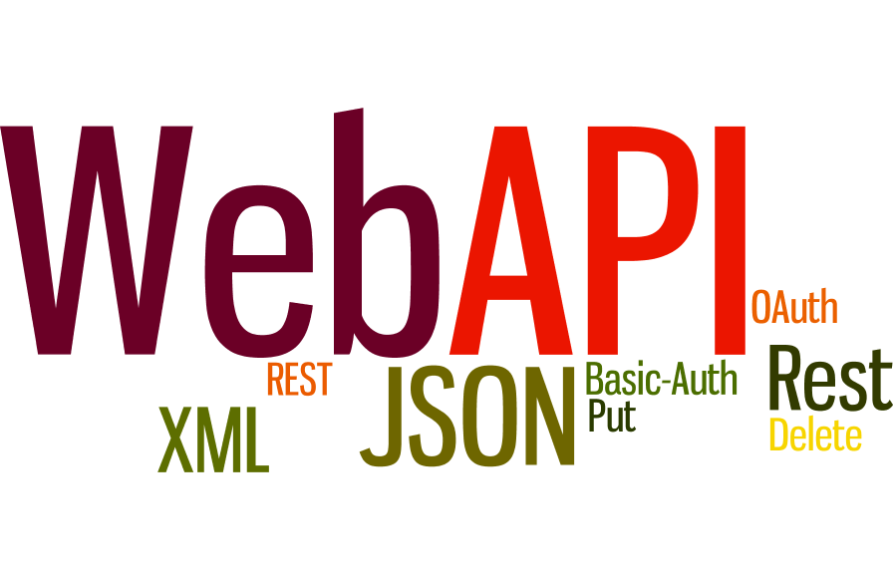

Slide 31
API
1. Asynchronous
2. Call back functions
3. Promises
4 Fetch Method
5 API
6 JSON
2. Learn more
It can extend the functionality of the browser
It can greatly simplify complex functions
It can provide easy syntax to complex code

Slide 32
API
1. Asynchronous
2. Call back functions
3. Promises
4 Fetch Method
5 API
6 JSON
2. Learn more
API stands for Application Programming Interface.
A Web API is an application programming interface for the Web.
A Browser API can extend the functionality of a web browser.
A Server API can extend the functionality of a web server.

Slide 33
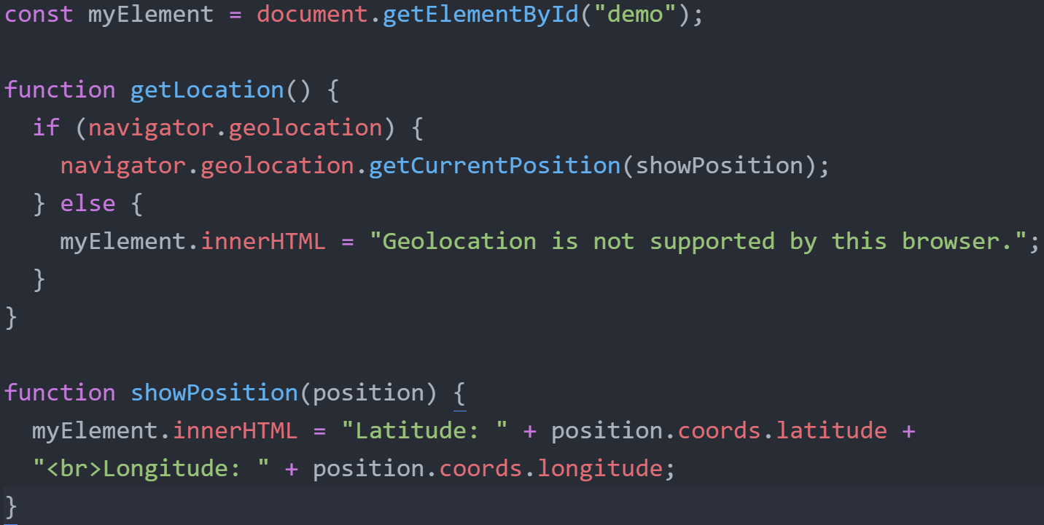
API
1. Asynchronous
2. Call back functions
3. Promises
4 Fetch Method
5 API
6 JSON
2. Learn more
All browsers have a set of built-in Web APIs to support complex operations, and to help accessing data.
For example, the Geolocation API can return the coordinates of where the browser is located.

Slide 34
API
1. Asynchronous
2. Call back functions
3. Promises
4 Fetch Method
5 API
6 JSON
2. Learn more
Third party APIs are not built into your browser.
To use these APIs, you will have to download the code from the Web.
Examples:
YouTube API - Allows you to display videos on a web site.
Twitter API - Allows you to display Tweets on a web site.
Facebook API - Allows you to display Facebook info on a web site.

Slide 35
API
1. Asynchronous
2. Call back functions
3. Promises
4 Fetch Method
5 API
6 JSON
2. Learn more
An API is simply a medium to fetch or send data between interfaces. Let’s say you want to make an application that provides the user with some real-time data fetched from the server or maybe even allows you to modify or add data to some other endpoint. This is made possible by the API or the Application Programming Interface.

Slide 36
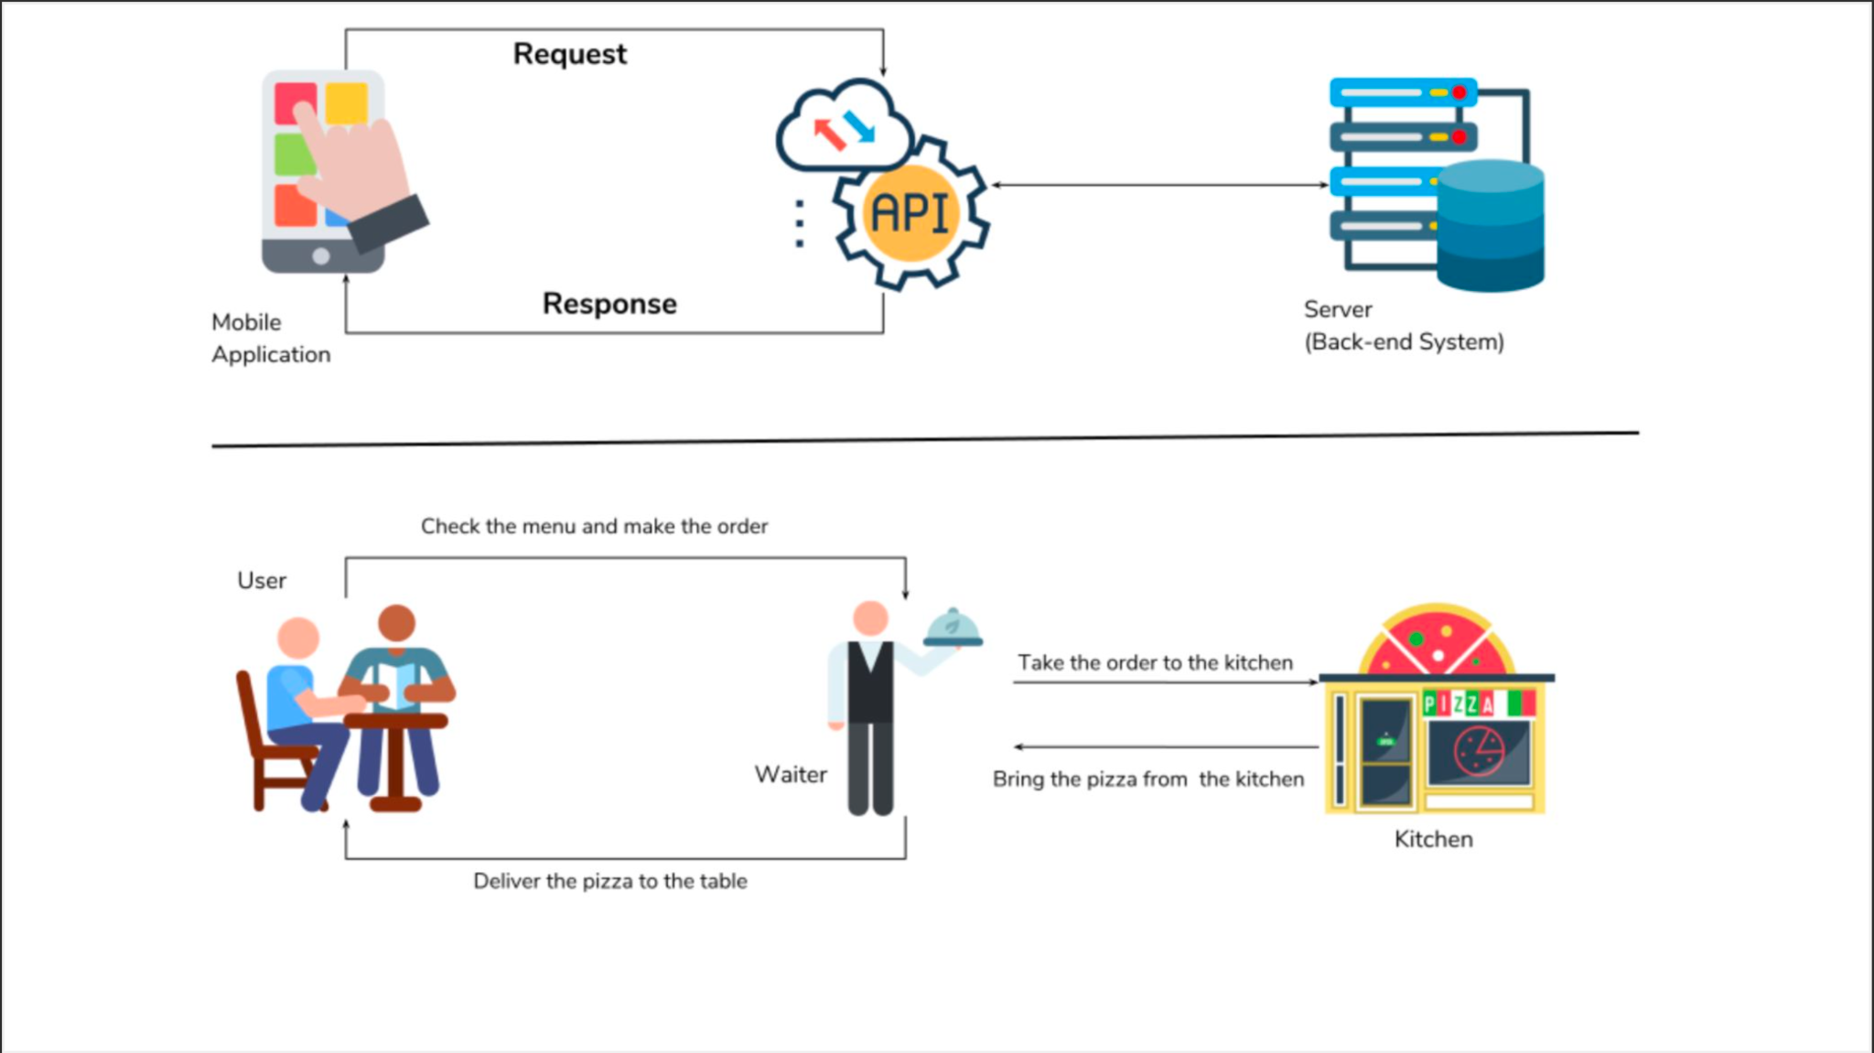
API
1. Asynchronous
2. Call back functions
3. Promises
4 Fetch Method
5 API
6 JSON
2. Learn more

Slide 37


Slide 38
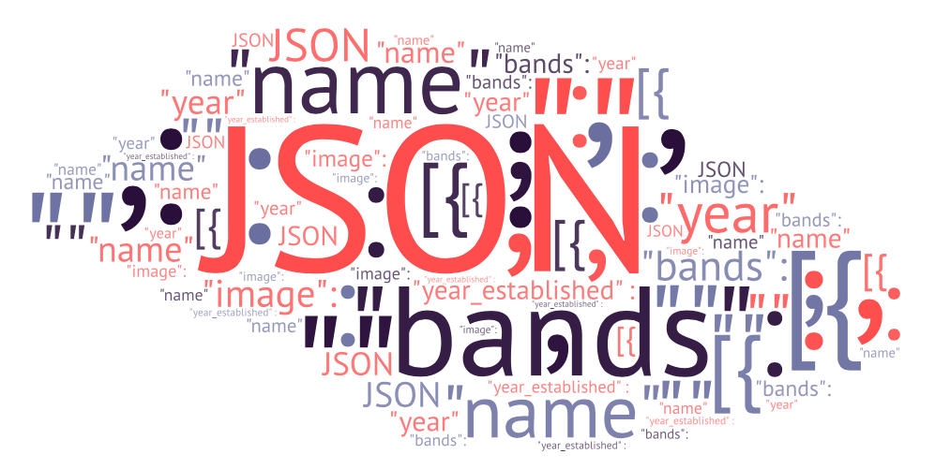

Slide 39
JSON
1. Asynchronous
2. Call back functions
3. Promises
4 Fetch Method
5 API
6 JSON
2. Learn more
JSON stands for JavaScript Object Notation
JSON is a text format for storing and transporting data
JSON is "self-describing" and easy to understand
JSON is often used when data is sent from a server to a web page
The JSON format is syntactically identical to the code for creating JavaScript objects. Because of this similarity, a JavaScript program can easily convert JSON data into native JavaScript objects.
The JSON syntax is derived from JavaScript object notation syntax, but the JSON format is text only. Code for reading and generating JSON data can be written in any programming language.

Slide 40
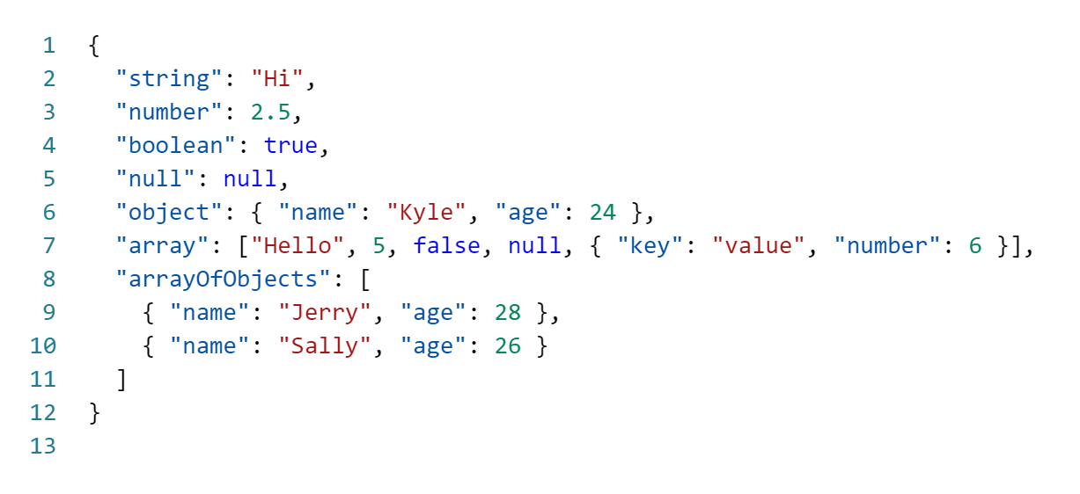
JSON
1. Asynchronous
2. Call back functions
3. Promises
4 Fetch Method
5 API
6 JSON
2. Learn more
JSON is a string whose format very much resembles JavaScript object literal format
You can include the same basic data types inside JSON as you can in a standard JavaScript object
strings, numbers, arrays, booleans, and other object literals

Slide 41
JSON
1. Asynchronous
2. Call back functions
3. Promises
4 Fetch Method
5 API
6 JSON
2. Learn more
Data is in name/value pairs
Data is separated by commas
Curly braces hold objects
Square brackets hold arrays

Slide 42
JSON
1. Asynchronous
2. Call back functions
3. Promises
4 Fetch Method
5 API
6 JSON
2. Learn more
The JSON format is syntactically similar to the code for creating JavaScript objects. Because of this, a JavaScript program can easily convert JSON data into JavaScript objects.
Since the format is text only, JSON data can easily be sent between computers, and used by any programming language.
JavaScript has a built in function for converting JSON strings into JavaScript objects:
JSON.parse()
JavaScript also has a built in function for converting an object into a JSON string:
JSON.stringify()

Slide 43
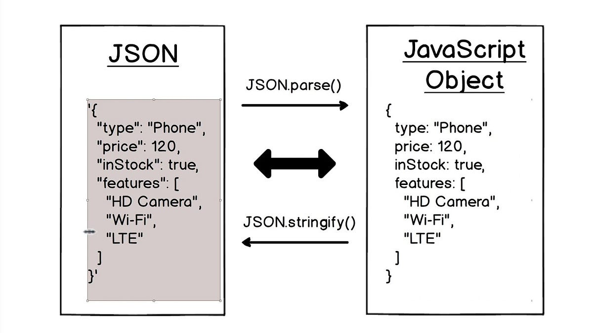
JSON
1. Asynchronous
2. Call back functions
3. Promises
4 Fetch Method
5 API
6 JSON
2. Learn more

Slide 44
JSON
1. Asynchronous
2. Call back functions
3. Promises
4 Fetch Method
5 API
6 JSON
2. Learn more
JSON data consists of key/value pairs similar to JavaScript object properties. The key and values are written in double quotes separated by a colon :. For example,
// JSON data
"name": "John"
Note: JSON data requires double quotes for the key.

Slide 45
JSON
1. Asynchronous
2. Call back functions
3. Promises
4 Fetch Method
5 API
6 JSON
2. Learn more
The JSON object is written inside curly braces { }. JSON objects can contain multiple key/value pairs. For example,
// JSON object
{ "name": "John", "age": 22 }

Slide 46
JSON
1. Asynchronous
2. Call back functions
3. Promises
4 Fetch Method
5 API
6 JSON
2. Learn more
JSON array is written inside square brackets [ ]. For example,
// JSON array
[ "apple", "mango", "banana"]
// JSON array containing objects
[
{ "name": "John", "age": 22 },
{ "name": "Peter", "age": 20 }.
{ "name": "Mark", "age": 23 }
]

Slide 47
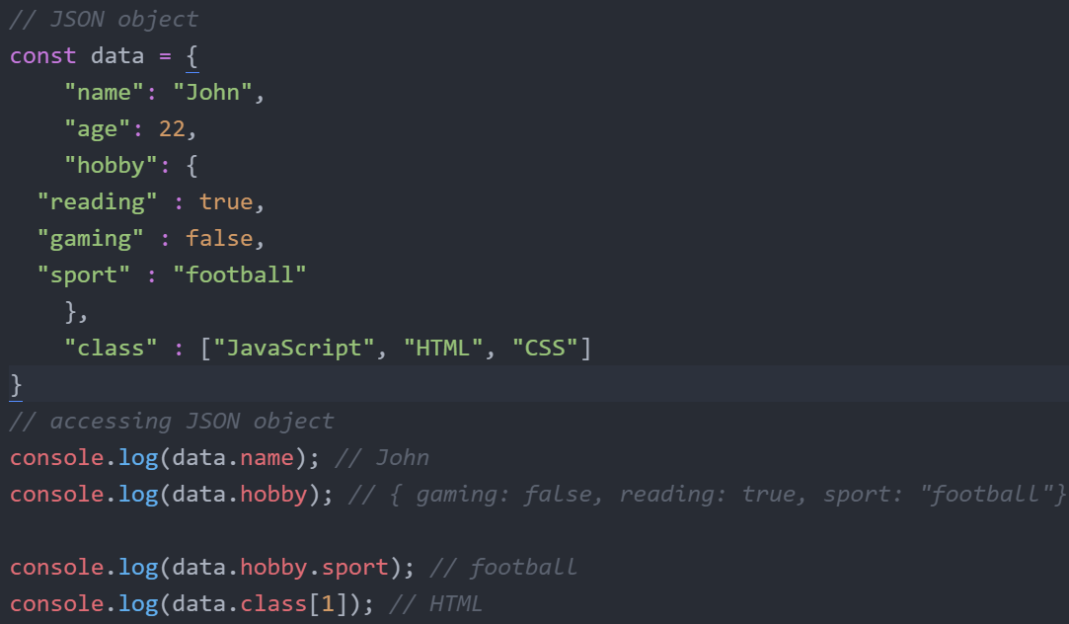
JSON
1. Asynchronous
2. Call back functions
3. Promises
4 Fetch Method
5 API
6 JSON
2. Learn more
You can access JSON data using the dot notation. For example,

Slide 48
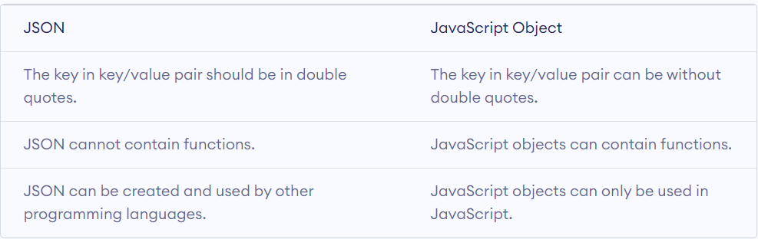
JSON
1. Asynchronous
2. Call back functions
3. Promises
4 Fetch Method
5 API
6 JSON
2. Learn more
Though the syntax of JSON is similar to the JavaScript object, JSON is different from JavaScript objects.

Slide 49
Learn More
1. Asynchronous
1.1. Call back functions
1.2. Promises
1.3. Fetch Method
1.4 API
1.5 JSON
2. Learn more
Working with APIs in JavaScript - GeeksforGeeks
Web APIs (w3schools.com)
JSON Introduction (w3schools.com)
JSON
Working with JSON - Learn web development | MDN (mozilla.org)

Slide 50
Learn More
1. Asynchronous
1.1. Call back functions
1.2. Promises
1.3. Fetch Method
1.4 API
1.5 JSON
2. Learn more
HTML DOM Events
HTML DOM Elements
JavaScript Promise
All about Promise

